Slide 1
Recent progress in the study of fission barriers in covariant density functional theory.
Anatoli Afanasjev
Mississippi State University
1. Motivation
2. Outline of formalism
3. Role of pairing.
4. Fission barriers in actinides:
role of triaxiality
5. Single-particle states
6. Fission barriers in superheavy nuclei
Collaborators: H. Abusara, S.Shawaqweh, P.Ring, G.Lalazissis
and S. Karatzikos

Slide 2
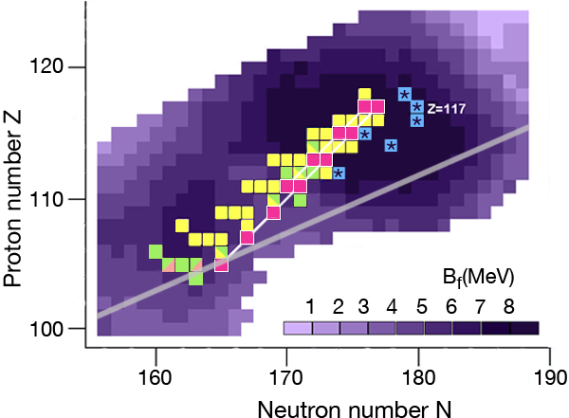
SEDF
CDFT
MM
Self-consistent theories give the
largest variations in the predictions
of magic gaps
at Z=120, 126 and 172, 184

Slide 3
Need for accurate description of fission barriers
since they strongly affect:
1. The probability for the formation of superheavy nuclei in
heavy-ion-fussion reaction (the cross-section very sensitively
depends on the fission barrier height).
survival probability of an excited nucleus in its cooling
by emitting neutrons and γ-rays in competition with fission
(the changes in fission barrier height by 1 MeV changes the
calculated survival probability by about one order of magnitude
or more)
3. spontaneous fission lifetimes
The landscape of PES is an input for the calculations beyond mean
field (such as GCM). Fission barriers provide a unique opportunity
to test how DFT describe this landscape.

Slide 4
Stability against fission
CDFT - low barriers,
Skyrme EDF – high barriers
from Burvenich et al PRC 69,
014307 (2004)

Slide 5
Why relativistic treatment based
on Dirac equation?
No relativistic kinematics,
HOWEVER
1. Spin degrees of freedom as well
as spin-orbit interaction are obtained
in a natural way (no extra parameters).
Spin-orbit splittings are properly
described.
2. Pseudospin symmetry is a relativistic
effect. J.Ginocchio, PRL 78, 436 (1997)
3. Time-odd mean fields are defined
via Lorentz covariance → very
weak dependence on the RMF
parametrization. AA, H. Abusara,
PRC 81, 014309 (2010)

Slide 6
Covariant density functional (CDF) theory
The nucleons interact via the exchange of effective mesons →
→ effective Lagrangian
Long-range
attractive
scalar field
Short-range
repulsive vector
field
Isovector
field
- meson fields
Mean
field
Eigenfunctions

Slide 7
Pairing in fission barriers.

Slide 8
1. RMF + BCS framework
g=0.8, 0.9, 1, 1.1, 1.2
²⁴⁰Pu
S.Karatzikos, AA,
G.Lalazissis, P.Ring,
PLB 689, 72 (2010)
Energy E [MeV]

Slide 9
2. RHB framework
²⁴⁰Pu

Slide 10
Dependence of the fission barrier
height on the cut-off energy E_{cut-off}
Gogny force has finite range,
which automatically guarantees a proper cut-off in momentum
space
defined in ND-minimum
includes high momenta and
leads to a ultra-violet divergence
to avoid
divergencies

Slide 11
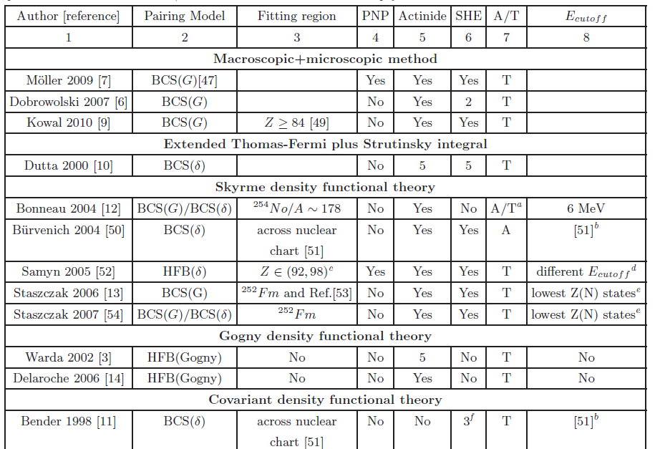
Summary of modern fission barrier calculations

Slide 12
The limitations of axially symmetric calculations.

Slide 13
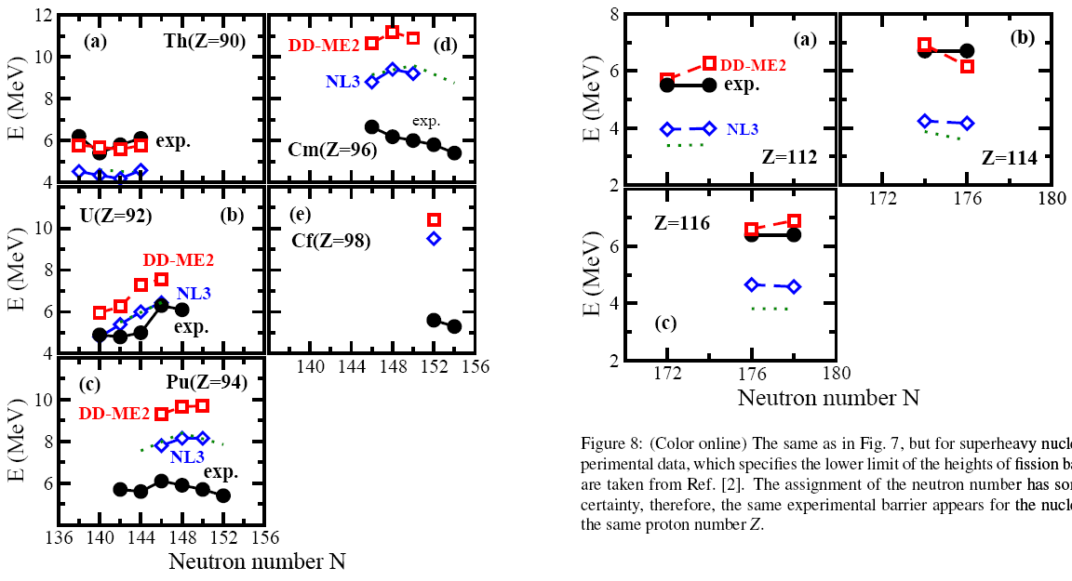
Heights of the fission barriers
Axially symmetric RHB calculations with D1S Gogny force
for pairing versus experiment

Slide 14
Extrapolation to superheavy nuclei:
uncertainties in the fission barrier height due
to the uncertainties in the pairing strength

Slide 15
Inner fission barriers in actinides:
the role of triaxiality.

Slide 16
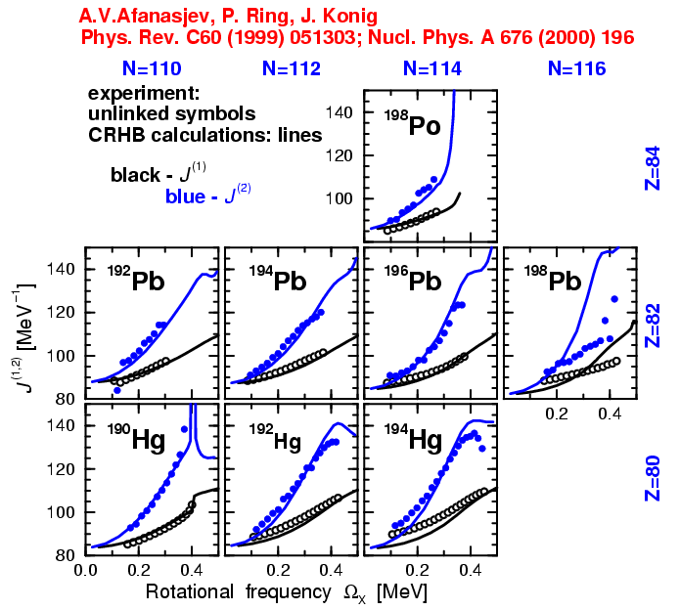
Triaxial RHB code with Gogny
force in pairing channel has
been developed ~ 10 years
ago for the description of
rotating nuclei.
However, the calculations in its framework are too computationally expensive.
Use RMF+BCS framework with monopole pairing:
required computational time is ~ 20-25 times smaller.
(Actinides)

Slide 17
Constrained calculations
Quadratic constraint
Augmented
Lagrangian
method
(A.Staszack et al,
Eur. Phys. J. A46, 85
(2010)
is also implemented but
its use is not required in
the majority of the cases
Fission path
²⁴⁰Pu

Slide 18
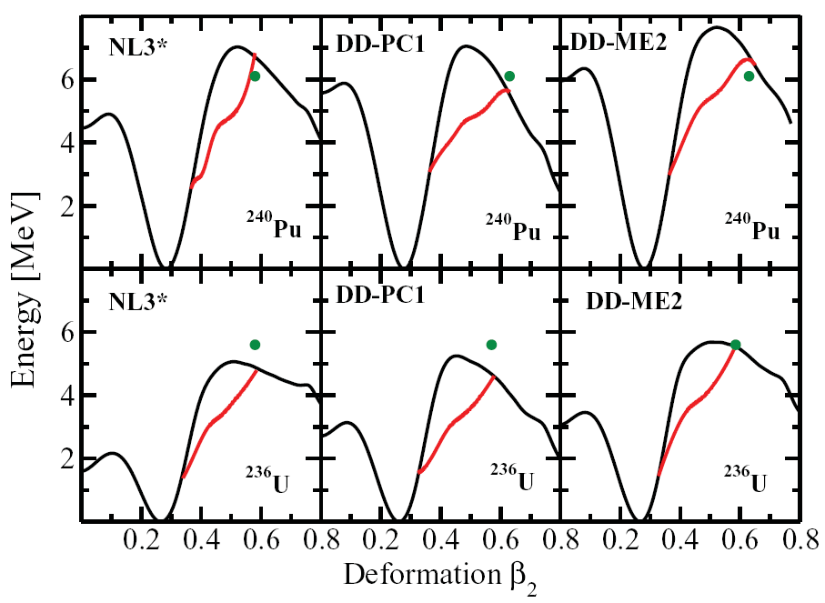
Parametrization dependence of fission barriers
Three classes of the CDFT forces:
NL3* - non-linear meson exchange
DD-ME2 – density dependent meson exchange
DD-PC1 – density dependent point coupling [no mesons]

Slide 19
Dependence of fission barriers
on pairing cutoff
Eq.(13) - use of smooth energy-
-dependent cutoff weights
[M.Bener et al, EPJ A 8, 59 (2000)
Solid lines –axial
Dashed lines -triaxial

Slide 20
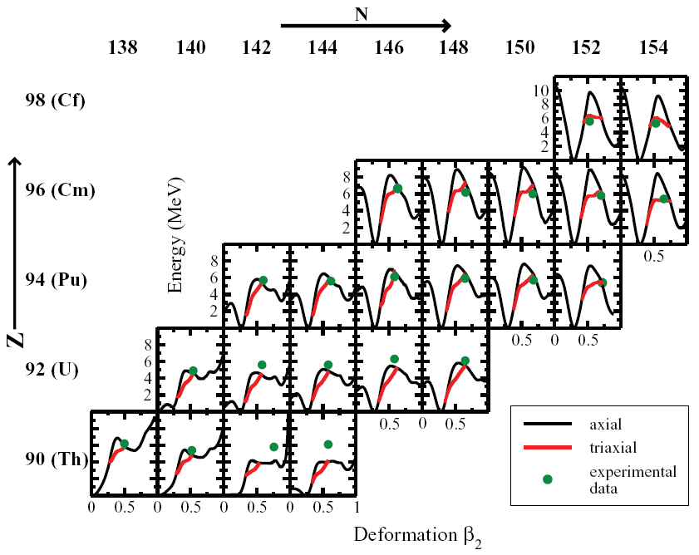
RMF(NL3*)+BCS
1. N_{F}=20 and N_{B}=20
2. E_{cut-off} =120 MeV, monopole pairing
3. Q₂₀ , Q₂₂ constraints

Slide 21
Gamma-deformations along the triaxial part of the fission path

Slide 22
The microscopic origin of the lowering of
the barrier due to triaxiality
The lowering of the
level density at the
Fermi surface induced
by triaxiality
leads to a more
negative shell correction
energy (as compared
with axially
symmetric solution),
and, as a consequence,
to a lower fission
barrier.
the deformation of the saddle
point obtained in the axially symmetric solution.

Slide 23
Particle number dependences of
the deviations between calculated and experimental
fission barrier heights.
They are still not completely resolved.
They are similar in different approaches.
Theoretical sources:
MM (Dobrowolski) -- J. Dobrowolski et al, PRC 75, 024613 (2007).
MM (Moller) -- P. M¨oller et al, PRC 79, 064304 (2009).
CDFT – H. Abusara, AA and P.Ring, PRC 82,044303 (2010) 044303
ETFSI – http://www-nds.iaea.org/ripl2/fission.html
Gogny - J.-P. Delaroche et al, NPA 771, 103 (2006)
Experimental (RIPL) data by Maslov:
http://www-nds.iaea.org/ripl2/fission.html

Slide 24
[in MeV] –
average
deviation
per nucleus

Slide 25
[in MeV] –
average
deviation
per nucleus
Neutron
numbers

Slide 26
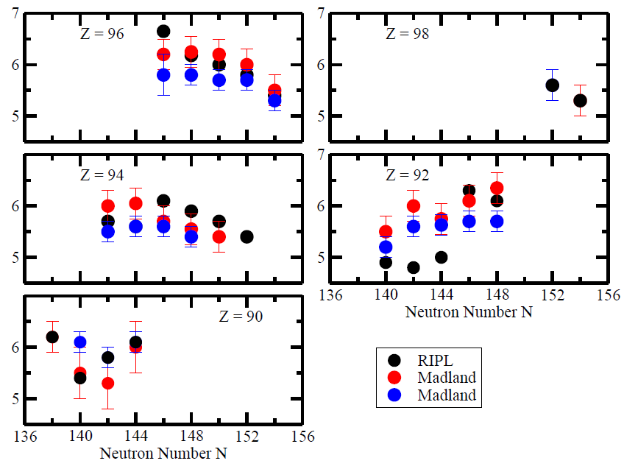
Experimental data are not unique
D. G. Madland and P. M”oller,
Los Alamos unclassified report,
LA-UR-11-11447

Slide 27
Deformed single-particle energies:
How sensitive are inner fission barriers
to the accuracy of their description?

Slide 28
Systematics of one-quasiparticle states in actinides: the CRHB study
Triaxial CRHB; fully self-consistent blocking, time-odd mean fields included,
Gogny D1S pairing
Neutron number N

Slide 29
Statistical distribution of deviations of the energies of
one-quasiparticle states from experiment
1. ~ 5% of calculated states have
triaxial deformation
2. For a given state, the deviation
from experiment depends on
particle number (consequence
of the stretching out of energy
scale due to low effective mass)
3. For some of the states, there is
persistent deviation from
experiment (due to wrong
placement of subshell
at spherical shape).
Two sources of deviations:
Low effective mass (stretching of the energy scale)
Wrong relative energies of the states

Slide 30
Illustration of energy scale stretching due to low effective
mass of the nucleon
Low effective mass (~0.6)
High effective mass (1.0)

Slide 31
Accuracy of the description of the
energies of deformed one-quasiparticle
states in actinides in RHB calculations:
correction for low Lorentz effective mass
Energy scale is corrected for low effective mass
75-80% of the states are described with an accuracy of phenomenological
(Nilsson, Woods-Saxon) models
The remaining differences are due to incorrect relative energies of
the single-particle states

Slide 32
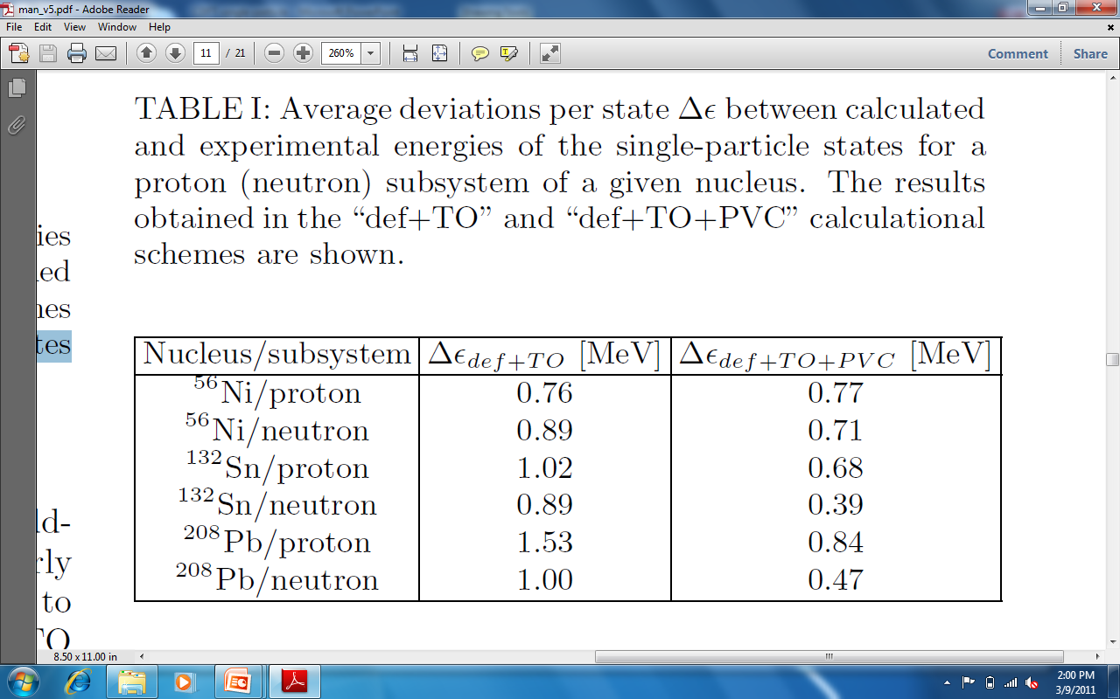
Relativistic particle-vibration coupling model: The deviations of calculated energies of the single-particle states
from experimental ones
The results for proton and
neutron states are given by
solid and open circles.
E.V. Litvinova and AA,
PRC 84, 014305 (2011)

Slide 33
Fission barriers in superheavy nuclei.

Slide 34
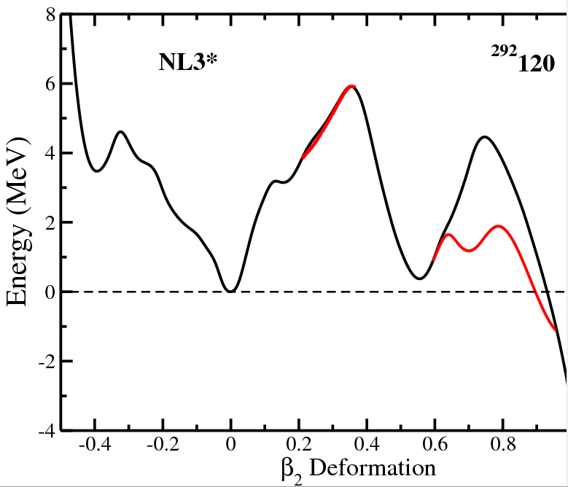
Triaxiality is important
in second fission
barrier, but has little
importance in the first
fission barrier
of studied superheavy nuclei
Triaxial solution
(shown only if
lower in energy
than axial solution
Axially
symmetric
solution
R.A.Gherghescu, J.Skalski, Z.Patyk,
A. Sobiczewski, NPA 651 (1999) 237

Slide 35
Solid lines – axially
symmetric solution
Dashed lines – triaxial solution

Slide 36
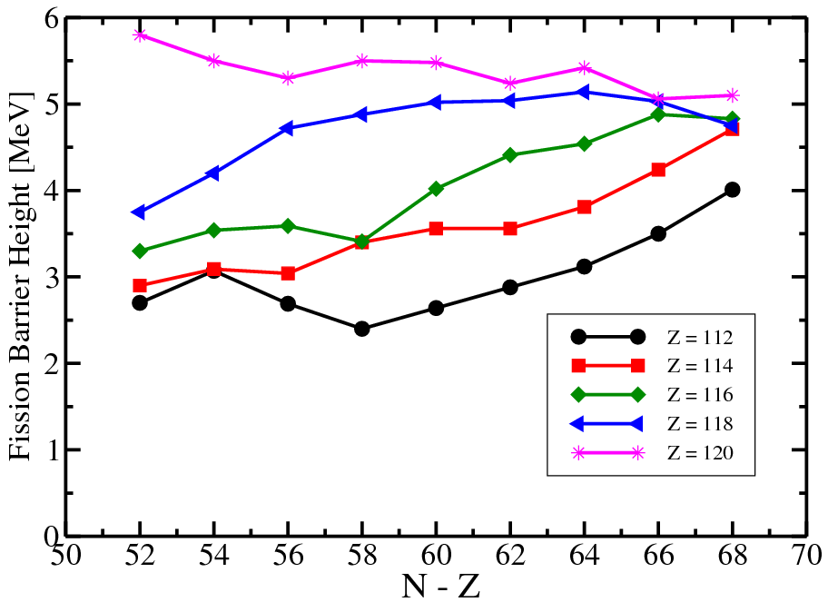
The fission barrier height as a function of
particle (Z, N) numbers
Z=120, N=172

Slide 37
The fission barrier height as a function of
particle (Z, N) numbers
Deformation of ground state

Slide 38
Conclusions
1. The treatment of pairing may lead to theoretical uncertainties
in the fission barrier heights of around 0.5 MeV. They are
present in all theoretical approaches. Experimental data on pairing
in the SD minima of actinides can provide extra constraint.
2. The inclusion of triaxiality brings calculated inner fission
barrier heights in the actinides in close agreement
with experiment ; the level of agreement with experiment
is comparable with best macroscopic+microscopic
calculations
3. Triaxiality does not play an important role at inner fission
barriers of studied superheavy nuclei. On the contrary, outer
fission barriers are strongly affected by triaxiality.
4. Stability of SHE with respect of fission increases on
approaching Z=120; the fission barriers reach the values
comparable with the ones in actinides

